Slide 1
devsecops
ow

Slide 2
overview
DevSecOps stands for Development, security and Operations. It is extension of DevOps practices.
Security means introduction of security practices in software development cycle. Each coder ensures the code are free of security vulnerability and security practice as the part of software lifecycle.
During the code push, when we plan CICD pipeline, Security and Code scanning become the part of our normal CICD cycle.
The primary goal is to identify vulnerabilities early in the development cycle.

Slide 3
Software development lifecycle
The Software Development Lifecycle (SDLC) is a systematic framework designed to help software teams create high-quality applications. By following the SDLC, teams can lower costs, reduce errors, and ensure the software consistently meets project objectives. Phases:
Requirement Analysis
Planning
Software Development
Testing
Deployment

Slide 4
Benefits of devsecops
Identify software vulnerabilities at an early stage
Accelerate time to market
Maintain adherence to regulatory requirements
Foster a culture of security awareness
Implement new features with security

Slide 5
Identify software vulnerabilities
Software teams prioritize security controls throughout the entire development lifecycle. Rather than waiting until the software is finished, they perform checks at each stage.
This enables teams to identify security issues early, reducing both the cost and time required to address vulnerabilities.
As a result, users benefit from a more secure application with minimal disruption post-release.

Slide 6
Development Efficiency and Compliance
DevSecOps enables software teams to automate security tests, minimizing human errors and ensuring that security assessments do not slow down the development process.
By adopting best practices and technologies for security, software teams utilize DevSecOps to meet regulatory requirements.
They identify system data protection and security needs, such as using AWS Security Hub to automate security checks aligned with industry standards.

Slide 7
Security Awareness and Collaboration
Software teams become more attuned to security best practices during application development. They proactively identify potential security vulnerabilities in the code, modules, or technologies used in building the application.
DevSecOps promotes seamless collaboration between development, operations, and security teams. With a shared understanding of software security and the use of common tools for automating assessments and reporting, all teams focus on delivering greater value to customers without sacrificing security.

Slide 8
How devsecops works?
DevSecOps integrates security into the DevOps process by embedding security assessments throughout the CI/CD pipeline. It turns security into a collective responsibility for all team members involved in software development.
The development team works closely with the security team before writing any code, while operations teams continue to monitor the software for security concerns after deployment.
This approach enables companies to deliver secure software more quickly while maintaining compliance

Slide 9
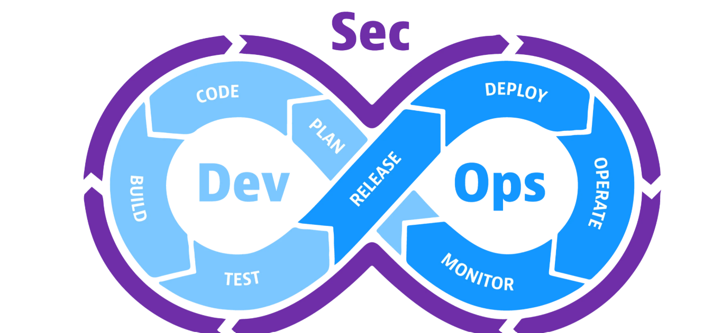
..

Slide 10
Devops vs devsecops
DevOps is a methodology that unites development, operations, and security teams to accelerate the software development lifecycle.
DevSecOps enhances this by embedding security into the DevOps process from the outset. It ensures security is prioritized throughout the entire software development lifecycle, rather than being an afterthought.
Key differences between DevSecOps and DevOps include:
DevSecOps involves a wider range of stakeholders, including security teams.
DevSecOps mandates a more thorough approach to security testing and scanning.
DevSecOps emphasizes stronger compliance with security regulations.

Slide 11
..
Features | Devops | Devsecops
Focus | Speed and Agility | Security
When to start security testing | Later in dev | From the start of CICD
Who is responsible for security | Security Team | Everyone
Culture | Security aspects most of team are not aware about practices, take as barrier in speed of release | Security is everyone responsibility, everyone will aware about the process

Slide 12
DevSEcops Principles
Shift left :Shift left is the process of checking for vulnerabilities in the earlier stages of software development. By following the process, software teams can prevent undetected security issues when they build the application. For example, developers create secure code in a DevSecOps process.
Shift right :Shift right indicates the importance of focusing on security after the application is deployed. Some vulnerabilities might escape earlier security checks and become apparent only when customers use the software.

Slide 13
Shift left : Culture
Security should be a standard requirement
Product managers and engineers should always be challenged
Understand and prioritize end-user needs in services
All components should be considered by ethical hackers
Innovation driven by manual ethical hacking techniques

Slide 14
Shift left: Automation
Inclusion of security in CI/CD pipeline
SAST (statistical analysis)
DAST (dynamic analysis)
Security code coverage analysis
Digitally signed secure repositories for built binaries
Penetration tests
Smoke tests

Slide 15
Shift left : Lean
Security-integrated definitions
Security-focused designs
Security-driven engineering
Security-inclusive testing
Security-conscious deployments

Slide 16
Reactive: Shift right [culture]
Adopt the mindset that no system is completely invulnerable
Conduct production smoke testing from the very beginning as part of monitoring and observability
Apply chaos engineering in both production and non-production environments
Perform root cause analysis using real-time data capture

Slide 17
.. Automation and Lean Practices
Continuously monitor security in both production and non-production environments
Implement chaos engineering with automated security testing in production
Treat major incident management as a value stream—every second matters!
Minimize response times to halt an attack
Speed up response times to restore value
Provide feedback to engineering to prevent future issues and address technical debt

Slide 18
Common factors: Measurements
Security professionals define measures based on regulatory requirements, such as GDPR
Measure security in both production and non-production environments
Define security as a key part of business value and success criteria
Real-time updates of security scorecards

Slide 19
sharing
Every part of the organization should take responsibility for security
The ability to independently identify and implement security measures
In case of an attack, a security-led damage analysis team, supported by IT, should work alongside an IT-led remediation team, supported by security
Leadership should empower teams with shared accountability in a safe environment, including red team vs. blue team exercises and security drills

Slide 20
Devsecops tools
Static application security testing :Static application security testing (SAST) tools analyze and find vulnerabilities in proprietary source code.
Software composition analysis :Software composition analysis (SCA) is the process of automating visibility into open-source software (OSS) use for the purpose of risk management, security, and license compliance.
Interactive application security testing :DevSecOps teams use interactive application security testing (IAST) tools to evaluate an application’s potential vulnerabilities in the production environment. IAST consists of special security monitors that run from within the application.
Dynamic application security testing :Dynamic application security testing (DAST) tools mimic hackers by testing the application's security from outside the network.

Slide 21
Challenges :Culture and adoption
The first challenge involves people and culture. You might find it necessary to retrain the people on your DevOps teams so they understand security best practices and know how to operate your new security tooling.
In terms of culture, your teams need to truly adopt the mindset that they’re responsible for the security of the software they build and deploy, just as much as they’re responsible for feature, function, and usability.

Slide 22
Finding right tool
A second challenge is finding the right security tooling and integrating it into your DevOps workflow.
The more automated your DevSecOps tooling is, and the more integrated it is with your CI/CD pipeline, the less training and culture-shifting you need to do.

Slide 23
Aws :DevSecOps implementation
AWS supports modern DevSecOps practices so that software teams can automate their applications’ security, compliance, and data protection. For example, you can do the following:
Use Amazon Inspector for automated and continual vulnerability management at scale.
Use AWS CodeCommit to manage source control and make incremental changes to the application.
Use AWS Secrets Manager to easily rotate, manage, and retrieve database credentials, API keys, and other secrets through their lifecycle.

Slide 24
Thanks
Q & A

